Slide 1
A Display Model
Lecture 16
Hartmut Kaiser
https://teaching.hkaiser.org/spring2024/csc3380/

Slide 2
Software Development Notes

Slide 3
Singleton Pattern
Singleton pattern ensures that there will only be one instance of a particular class
Instead of creating an object directly (and globally):
    some_type global(…);
We use a static method:
    some_type& global = some_type::get_instance();
some_type::get_instance() always returns the same instance
Therefore, it is different from a factory (pattern), which creates new objects

Slide 4
What’s Wrong With It?
Singletons are “anti-functional”
  And bad for multi-threaded contexts
They’re essentially a fancy global variable
Global variables are useful sometimes, but usually they’re a terrible idea
  They make refactoring more difficult
  They make testing much more difficult
  They make reasoning about system behavior more difficult
  They create additional issues in multi-threaded environments
Sometimes they are useful in spite of the above

Slide 5
Where you see it
Singleton is associated with factories:
  The factory itself can be a singleton (configuration managers)
It is common when accessing hardware resources:
    mouse::get_instance();
    screen::get_instance();

Slide 6
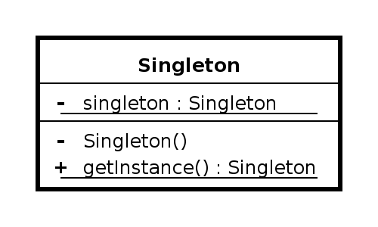
Singleton Class Diagram
Singleton has the easiest UML class diagram

Slide 7
3 Things Worth Noting
The constructor is private
  Why?
  Because if it weren’t, the user could create more than one instance, defeating the purpose
The instance field is a (function-local) static (indicated by underline) and private
  Why?
  Static because it’s an easy way to ensure that there is exactly one, globally accessible field
  Private to force users to use get_instance
The only way to access the instance is through the get_instance method (which is also static)
  This is where we return a reference to the one instance, or create it if it doesn’t exist (on first access)

Slide 8
Example
class graphics_manager {
private:
graphics_manager() { ... }
public:
static graphics_manager& get_instance()
{
static graphics_manager instance; // created on first access
return instance;
}
// ... Other (non-static) functionalities
}

Slide 9
Benefits of Function-local static
Correct order of initialization is forced, so it can’t be wrong
The instances are also not global, which reduces coupling
Basically, this is what you should do instead of using a global in almost every circumstance

Slide 10
A Display Model

Slide 11
Abstract
This lecture presents a display model (the output part of a GUI), giving examples of use and fundamental notions such as screen coordinates, lines, and color. Some examples of shapes are Lines, Polygons, Axis, and Text.

Slide 12
Overview
Why graphics?
A graphics model
Examples

Slide 13
Why bother with graphics and GUI?
It’s very common
  If you write conventional PC applications, you’ll have to do it
It’s useful
  Instant feedback
  Graphing functions
  Displaying results
It can illustrate some generally useful concepts and techniques

Slide 14
Why bother with graphics and GUI?
It can only be done well using some pretty neat language features ☺
Graphics are a good introduction to what is commonly known as ‘OOP’
Lots of good (small) code examples
It can be non-trivial to “get” the key concepts
  So it’s worth teaching
  If we don’t show how it’s done, you might think it was “magic”
Graphics is fun!

Slide 15
Why Graphics/GUI?
WYSIWYG
  What you see (in your code) is what you get (on your screen)
Direct correspondence between concepts, code, and output

Slide 16
A Display Model

Slide 17
Text vs. Graphics
So far we have seen text based stream IO
  Possible to do ‘graphics’
Simplest HTML:
    <!doctype html>
    <html lang="en-US">
    <head>
    <meta charset="utf-8" />
    <title>My test page</title>
    </head>
    <body>
    <p>This is my page</p>
    </body>
    </html>
Here and in the next lectures we will provide an alternative approach
  Directly aimed at the screen, drawing lines, rectangles, circles, etc.

Slide 18
Display Model
Objects (such as graphs) are “attached to” a window.
The “display engine” invokes display commands (such as “draw line from x to y”) for the objects in a window
Objects such as Square contain vectors of lines, text, etc. for the window to draw
Circle
attach()
draw()
Display
Engine
“window”
Square
attach()

Slide 19
Display Model
An example illustrating the display model
int main()
{
Graph_lib::Point tl(100, 200); // a point (obviously)
Simple_window win(tl, 600, 400, "Canvas"); // make a simple window
Graph_lib::Polygon poly; // make a shape (a polygon, obviously)
poly.add(Graph_lib::Point(300, 200)); // add three points
poly.add(Graph_lib::Point(350, 100));
poly.add(Graph_lib::Point(400, 200));
poly.set_color(Graph_lib::Color::red); // make the polygon red (obviously)
win.attach(poly); // connect poly to the window
win.wait_for_button(); // give control to the display engine
}

Slide 20
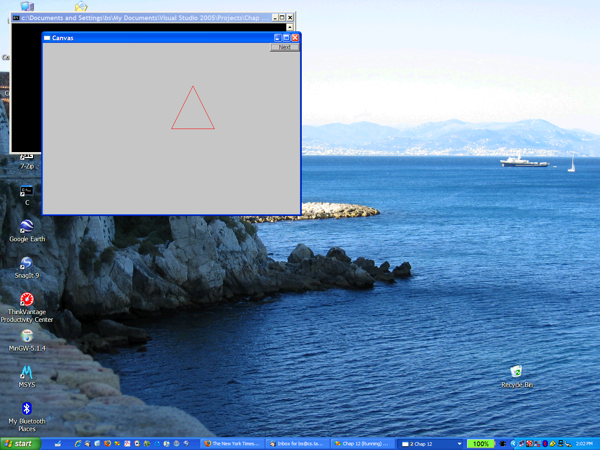
The Resulting Screen

Slide 21
Display Model
An example illustrating the display model
int main()
{
Graph_lib::Point tl(100, 200); // a point (obviously)
Simple_window win(tl, 600, 400, "Canvas"); // make a simple window
Graph_lib::Polygon poly; // make a shape (a polygon, obviously)
poly.add(Graph_lib::Point(300, 200)); // add three points
poly.add(Graph_lib::Point(350, 100));
poly.add(Graph_lib::Point(400, 200));
poly.set_color(Graph_lib::Color::red); // make the polygon red (obviously)
win.attach(poly); // connect poly to the window
win.wait_for_button(); // give control to the display engine
}

Slide 22
Graphics/GUI Libraries
You’ll be using a few interface classes we wrote
  Interfacing to a popular GUI toolkit
    GUI == Graphical User Interface
    FLTK: www.fltk.org // Fast Light Tool Kit, pronounced ‘FullTick’
  Installation, etc.
    FLTK
    Our GUI and graphics classes
    Project settings
This model is far simpler than common toolkit interfaces
  The FLTK (very terse) documentation is 1000 pages
  Our interface library is < 20 classes and < 500 lines of code
  You can write a lot of code with these classes
    And what you can build on them

Slide 23
Graphics/GUI libraries (cont.)
The code is portable
  Windows, Unix, Mac, etc.
This model extends to most common graphics and GUI uses
The general ideas can be used with any popular GUI toolkit
  Once you understand the graphics classes you can easily learn any GUI/graphics library
    Well, relatively easily – these libraries are huge

Slide 24
Graphics/GUI libraries
Often called “a layered architecture”
Your code
Your screen
Our interface library
A graphics/GUI library
(here FLTK)
The operating system
(e.g. Windows or Linux)

Slide 25
Coordinates
Oddly, y-coordinates “grow downwards” // right, down
Coordinates identify pixels in the window on the screen
You can re-size a window (changing x_max() and y_max())
0,0
200,0
50,50
200,100
0,100

Slide 26
Interface classes
An arrow means “is a kind of”
Color, Line_style, and Point are “utility classes” used by the other classes
Window is our interface to the GUI library (which is our interface to the screen)
Window
Color
Line_style
Shape
Point
Simple_window
Line
Lines
Polygon
…
Rectangle
Text

Slide 27
Interface classes
Current
  Color, Line_style, Font, Point,
  Window, Simple_window
  Shape, Text, Polygon, Line, Lines, Rectangle, …
  Axis
Easy to add (for some definition of “easy”)
  Grid, Block_chart, Pie_chart, etc.
Later, GUI
  Button, In_box, Out_box, …

Slide 28
Demo code 1
// Getting access to the graphics system
#include "Graph.h" // graphical shapes
#include "Simple_window.h" // stuff to deal with your system's windows
int main()
{
// make a simple window
// screen coordinate (100, 200) top left of window
// window size(600*400)
// title: Canvas
Simple_window win(Graph_lib::Point(100, 100), 600, 400, "Canvas");
win.wait_for_button(); // give control to the display engine
}

Slide 29

A “blank canvas”

Slide 30
Demo code 2
// make an Axis, an axis is a kind of Shape
// Axis::x means horizontal
// starting at (20, 300)
// 280 pixels long
// 10 "notches"
// text "x axis"
Graph_lib::Axis xa(
Graph_lib::Axis::x, Graph_lib::Point(20, 300), 280, 10, "x axis");
win.set_label("Canvas #2");
win.attach(xa); // attach axis xa to the window

Slide 31
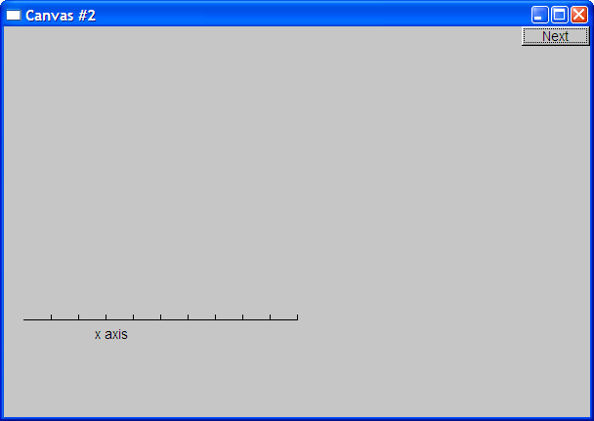
Add an X-axis

Slide 32
Demo code 3
win.set_label("Canvas #3");
Graph_lib::Axis ya(
Graph_lib::Axis::y, Graph_lib::Point(20, 300), 280, 10, "y axis");
ya.set_color(Graph_lib::Color::cyan); // choose a color for the axis
ya.label.set_color(Graph_lib::Color::dark_red); // choose a color for the text
win.attach(ya);

Slide 33
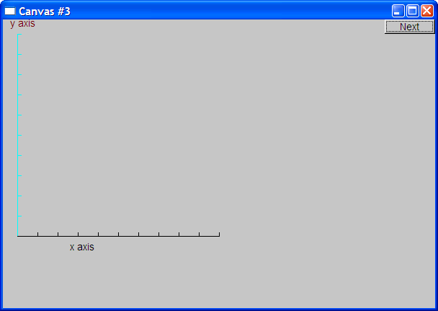
Add a Y-axis (colored)
Yes, it’s ugly, but this is a programming course, not a graphics design course

Slide 34
Demo code 4
win.set_label("Canvas #4");
// sine curve
// plot sin() in the range [0:100)
// with (0, 0) at (20, 150)
// using 1000 points
// scale x values * 50, scale y values * 50
Graph_lib::Function sine(std::sin, 0, 100, Graph_lib::Point(20, 150), 1000, 50, 50);
win.attach(sine);

Slide 35
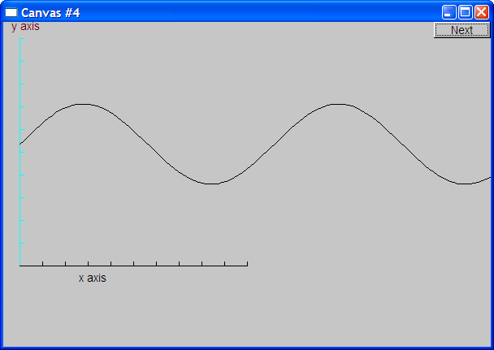
Add a sine curve

Slide 36
Demo code 5
win.set_label("Canvas #5");
sine.set_color(
Graph_lib::Color::blue); // I changed my mind about sine's color
Graph_lib::Polygon poly; // a polygon, a Polygon is a kind of Shape
poly.add(Graph_lib::Point(300, 200)); // three points makes a triangle
poly.add(Graph_lib::Point(350, 100));
poly.add(Graph_lib::Point(400, 200));
poly.set_color(Graph_lib::Color::red); // change the color
poly.set_style(Graph_lib::Line_style::dash); // change the line style
win.attach(poly);

Slide 37
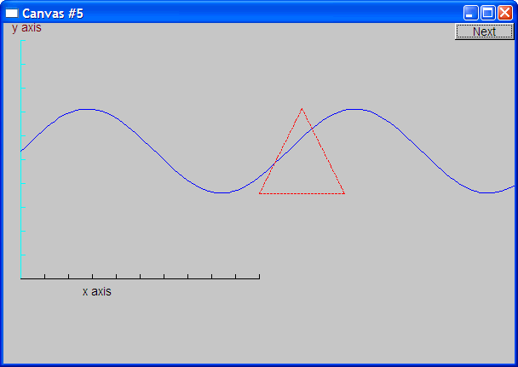
Add a triangle (and color the curve)

Slide 38
Demo code 6
// add a rectangular shape
// at position 200, 200
// of size 100*50
Graph_lib::Rectangle r(Graph_lib::Point(200, 200), 100, 50);
win.attach(r);

Slide 39
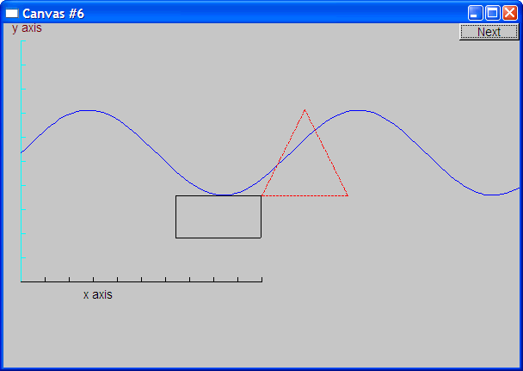
Add a Rectangle

Slide 40
Demo code 6.1
// Add a shape that looks like a rectangle
win.set_label("Canvas #6.1");
Graph_lib::Closed_polyline poly_rect;
poly_rect.add(Graph_lib::Point(100, 50));
poly_rect.add(Graph_lib::Point(200, 50));
poly_rect.add(Graph_lib::Point(200, 100));
poly_rect.add(Graph_lib::Point(100, 100));
win.attach(poly_rect);

Slide 41
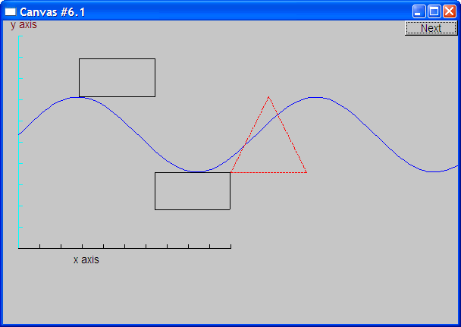
Add a Shape that looks like a Rectangle
But is it a rectangle?

Slide 42
Demo code 6.2
We can add a point
win.set_label("Canvas #6.2");
poly_rect.add(Graph_lib::Point(50, 75)); // now poly_rect has 5 points
“looking like” is not the same as “is”

Slide 43
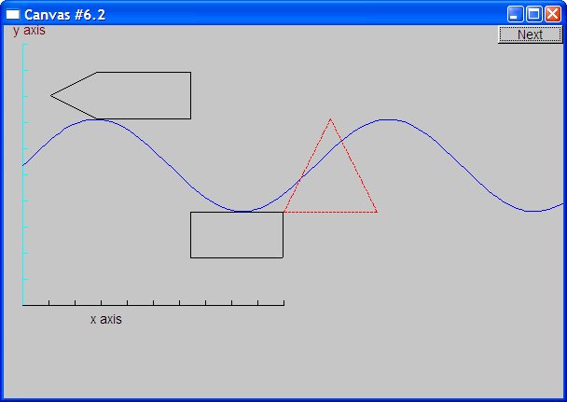
Obviously a polygon

Slide 44
Add fill
win.set_label("Canvas #7");
// color the inside of the rectangle
r.set_fill_color(Graph_lib::Color::yellow);
// make the triangle contour fat and dashed
poly.set_style(Graph_lib::Line_style(Graph_lib::Line_style::dash, 4));
poly_rect.set_fill_color(Graph_lib::Color::green);
poly_rect.set_style(Graph_lib::Line_style(Graph_lib::Line_style::dash, 2));

Slide 45
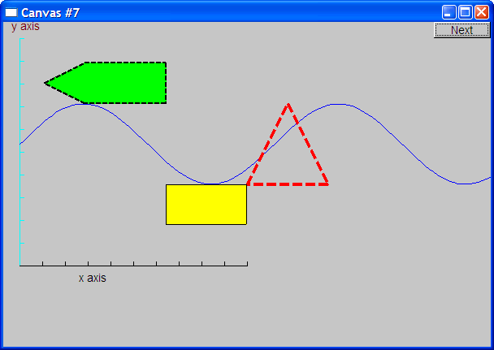
Add fill

Slide 46
Demo Code 8
win.set_label("Canvas #8");
// add text
Graph_lib::Text t(Graph_lib::Point(100, 100), "Hello, graphical world!");
win.attach(t);

Slide 47

Add text

Slide 48
Demo Code 9
Modify text font and size
t.set_font(Graph_lib::Font::times_bold);
t.set_font_size(20);

Slide 49
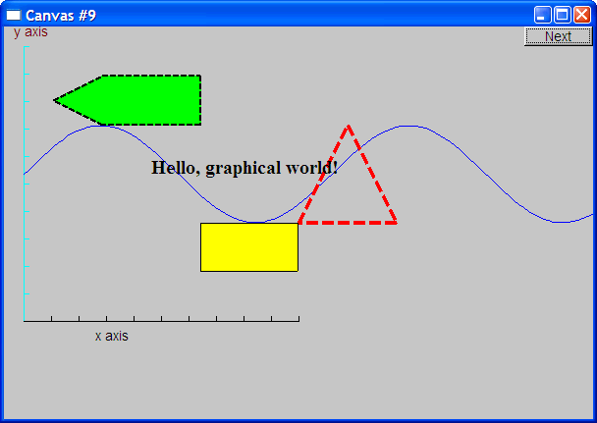
Text font and size

Slide 50
Add an Image
win.set_label("Canvas #10");
// open an image file
Graph_lib::Image ii(Graph_lib::Point(100, 50), "image.gif");
win.attach(ii);

Slide 51
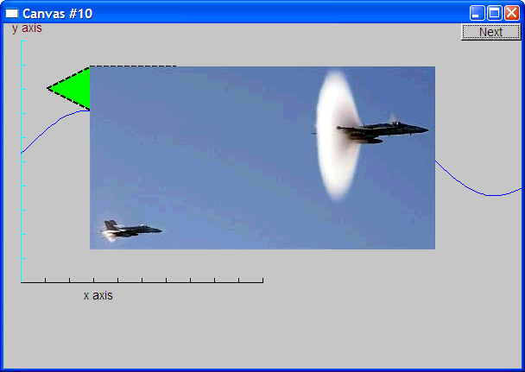
Add an image

Slide 52
Oops!
The image obscures the other shapes
  Move it a bit out of the way
win.set_label("Canvas #11");
ii.move(100, 200);

Slide 53
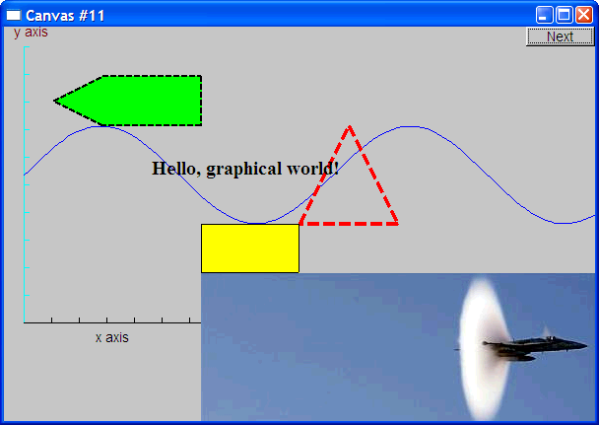
Move the Image
Note how the parts of a shape that don’t fit in the window are “clipped” away

Slide 54
Demo Code 12
win.set_label("Canvas #12");
Graph_lib::Circle c(Graph_lib::Point(100, 200), 50);
Graph_lib::Ellipse e(Graph_lib::Point(100, 200), 75, 25);
e.set_color(Graph_lib::Color::dark_red);
Graph_lib::Mark m(Graph_lib::Point(100, 200), 'x');
std::ostringstream oss;
oss << "screen size: " << Graph_lib::x_max() << "*" << Graph_lib::y_max()
<< "; window size: " << win.x_max() << "*" << win.y_max();
Graph_lib::Text sizes(Graph_lib::Point(100, 20), oss.str());
Graph_lib::Image cal(Graph_lib::Point(225, 225), "snow_cpp.gif"); // 320*240 pixel gif
cal.set_mask(Graph_lib::Point(40, 40), 200, 150); // display center of image
win.wait_for_button();

Slide 55
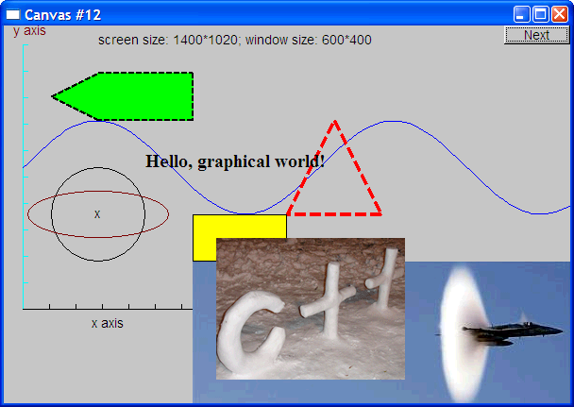
Add shapes, more text

Slide 56
Boiler Plate
#include "Graph.h" // graphical shapes
#include "Simple_window.h" // stuff to deal with your system's windows
int main()
try {
demo(); // the main part of your code
return 0;
}
catch (std::exception const& e) {
std::cerr << "exception: " << e.what() << '\n';
return 1;
}
catch (...) {
std::cerr << "Some exception\n";
return 2;
}

Slide 57
Code Organization
FLTK headers
Point.h:
struct Point { … };
FLTK code
Graph.h:
Window.h:
GUI.h:
// Graphing interface:
struct Point { … };
…
// window interface:
class Window {…};
…
// GUI interface:
struct In_box { … };
…
Graph.cpp:
Window.cpp:
GUI.cpp:
Graph code
Window code
GUI code
#include "Graph.h"
#include "Window.h"
int main() { … }
demo.cpp:

Slide 58
Primitives and Algorithms
The demo shows the use of library primitives
  Just the primitives
  Just the use
Typically what we display is the result of
  an algorithm
  reading data
Next lectures
  Graphics Classes
  Graphics Class Design
  Graphing Functions and Data
  Graphical User Interfaces

Slide 59
